Slide 1
CY 2023 Regulatory Update:
Medicare Home Health
Brian Slater, Director
Center for Medicare
Chronic Care Policy Group
Division of Home Health & Hospice
Brian.Slater@cms.hhs.gov
Kelly Vontran, Deputy Director
Center for Medicare
Chronic Care Policy Group
Division of Home Health & Hospice
Kelly.Vontran@cms.hhs.gov

Slide 2
FY 2023 Hospice Final Rule
Payment Policy Regulatory Update
CMS-1773-F
Published: July 29, 2022
Effective: October 1, 2022

Slide 3
Agenda
FY 2023 Hospice Final Rule:
  Hospice Payment Rate Update Percentage
  Hospice Payment Rates
  Hospice Cap
  Consolidated Appropriations Act, 2021: Hospice Cap
  Permanent Cap on Hospice Wage Index Decreases
  Hospice Impacts

Slide 4
FY 2023 Hospice Payment Update Percentage
The Inpatient Hospital Market Basket Update Percentage for FY 2023 is 4.1 percent minus the productivity factor of 0.3 percent.
The FY 2023 Hospice Payment Update Percentage is 3.8 percent.

Slide 5
FY 2023 Hospice Payment Rates
FY 2023 Payment Rates for Hospices that Submit Quality Data
Level of Care | FY 2022 Rates | Sia Budget Neutrality Factor | Wage-Index Budget Neutrality Factor | FY 2023 Hospice Payment Update | Final FY 2023 Payment Rates
RHC (Days 1-60) | $203.40 | 1.0003 | 1.0007 | 1.038 | $211.34
RHC (Days 61+) | $160.74 | 1.0003 | 1.0006 | 1.038 | $167.00
CHC | $1,462.52 ($60.94/hr.) | N/A | 1.0026 | 1.038 | $1,522.04 ($63.42/hr.)
IRC | $473.75 | N/A | 1.0007 | 1.038 | $492.10
GIP | $1,068.28 | N/A | 1.0017 | 1.038 | $1,110.76

Slide 6
FY 2023 Hospice Payment Rates
FY 2023 Payment Rates for Hospices that
DO NOT Submit Quality Data
Level of Care | FY 2022 Rates | Sia Budget Neutrality Factor | Wage-Index Budget Neutrality Factor | FY 2023 Hospice Payment Update | Final FY 2023 Payment Rates
RHC (Days 1-60) | $203.40 | 1.0003 | 1.0007 | 1.018 | $207.27
RHC (Days 61+) | $160.74 | 1.0003 | 1.0006 | 1.018 | $163.78
CHC | $1,462.52 ($60.94/hr.) | N/A | 1.0026 | 1.018 | $1,492.72 ($62.20/hr.)
IRC | $473.75 | N/A | 1.0007 | 1.018 | $482.62
GIP | $1,068.28 | N/A | 1.0017 | 1.018 | $1,089.36

Slide 7
FY 2023 Hospice Cap
The hospice cap is updated by the hospice payment update percentage rather than using the CPI–U.
The hospice cap amount for the FY 2023 cap year is $32,486.92, which is equal to the FY 2022 cap amount ($31,297.61) updated by the FY 2023 hospice payment update percentage of 3.8 percent.

Slide 8
Consolidated Appropriations Act, 2021: Hospice Cap
Division CC, section 404 of the CAA 2021 amended section 1814(i)(2)(B) of the Act and extended the provision that currently mandates the hospice cap be updated by the hospice payment update percentage (hospital market basket update reduced by the productivity adjustment) rather than the CPI–U for accounting years that end after September 30, 2016 and before October 1, 2030.*
*Note: Section 4162 of the CAA, 2023 extends the expiring provision to FY 2032.

Slide 9
Permanent Cap on Hospice Wage Index Decreases
  Application of a permanent 5% cap on any decrease to a geographic area’s wage index from its wage index in the prior year.
  Regardless of the circumstances causing the decline, CMS finalized that a geographic area’s wage index for FY 2023 and subsequent years, wouldn’t be less than 95% of its wage index in the prior FY.
  The appropriate wage index value will be applied to the labor portion of the hospice payment rate based on:
      Geographic area in which the beneficiary resides when receiving RHC or CHC
      Geographic location of the facility for beneficiaries receiving GIP or IRC
Note: The permanent 5% cap is not retroactive to FY 2022 wage index decreases.

Slide 10
FY 2023 Hospice Impacts
Estimated aggregate impact of the final rule payment provisions is an increase of $825 million in payments to hospices resulting from the hospice payment update percentage of 3.8 percent.
3.8%
3.8%

Slide 11
CY 2023 Home Health PPS Final Rule
Payment Policy Regulatory Update
CMS-1766-F
Published: November 4, 2022
Effective: January 1, 2023

Slide 12
Agenda
CY 2023 Home Health Final Rule
  Home Health Utilization
  Estimated Costs for 30-day Periods
  Behavior Change Payment Adjustments
  HH PPS Payment Rate Updates
  Reassignment of ICD-10 Codes
  Recalibration and LUPA Thresholds
  FDL Ratio
  Wage-Index Cap
  Telehealth G-Codes
  CY 2023 Estimated Impacts
Consolidated Appropriations Act of 2023 (CAA, 2023) Requirements

Slide 13
Home Health Utilization
In CY 2021 approximately 3.3 million Medicare beneficiaries received home health services.
There 9,900 certified home health agencies (HHAs).
Medicare Home Health expenditures were $17.1 billion in CY 2021.

Slide 14
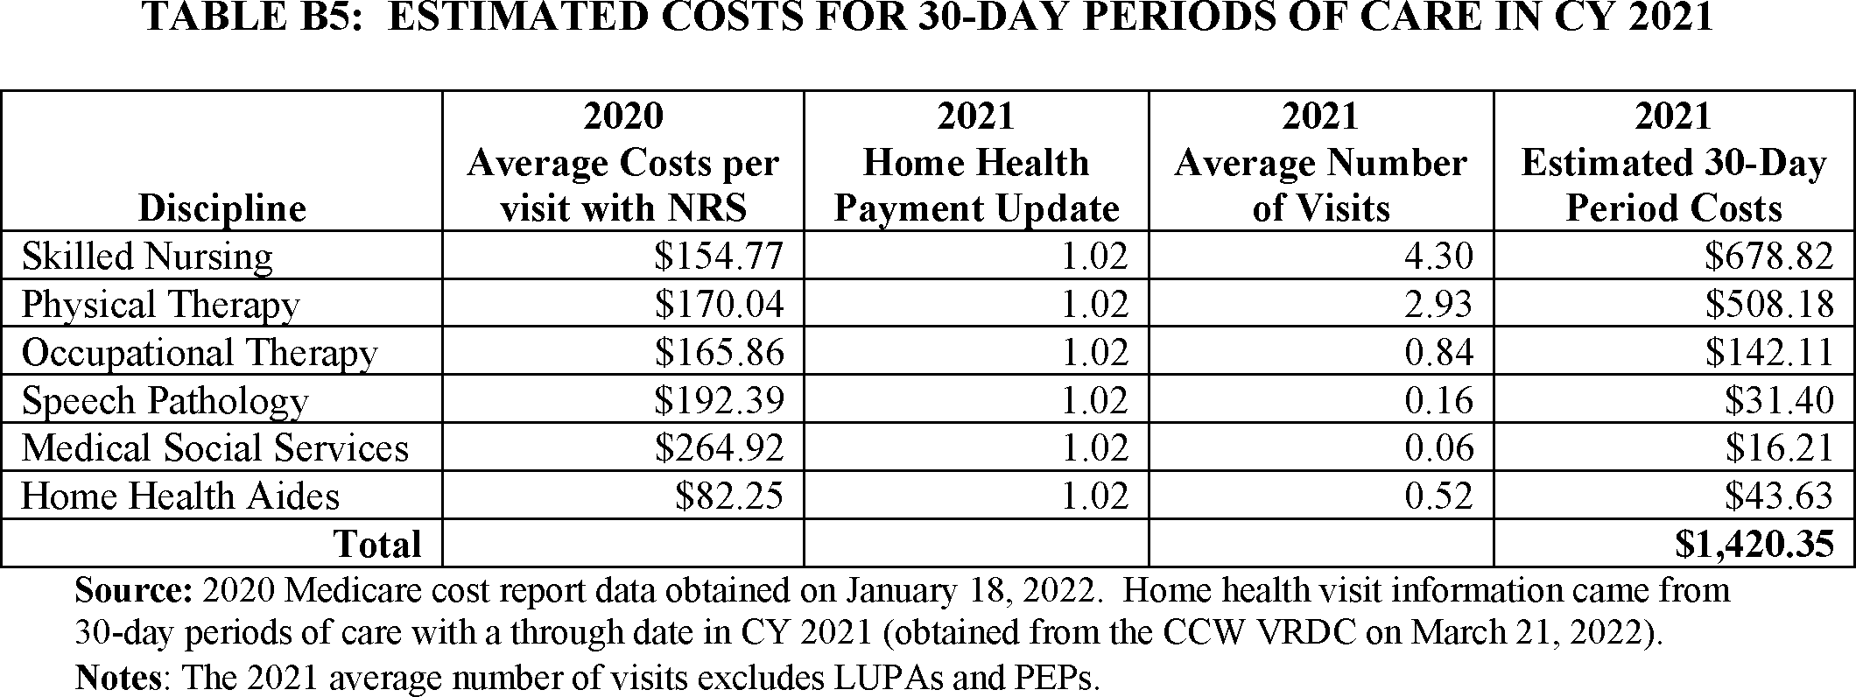
Estimated Costs for 30-Day Periods of Care
The CY 2021 national, standardized 30-day period payment rate was $1,901.12, which is approximately 34 percent more than the estimated CY 2021 30-day period average facility cost of $1,420.35.

Slide 15
Patient-Driven Groupings Model (PDGM) and Behavior Change Adjustments
Background:
On January 1, 2020, CMS implemented the Patient-Driven Groupings Model (PDGM) and 30-day unit for payment under the Home Health Prospective Payment System (HH PPS), as required by the Bipartisan Budget Act of 2018.
The law also required CMS to establish the payment to ensure that estimated aggregate expenditures under the PDGM would be equal to the estimated aggregate expenditures if the PDGM was not implemented.
In calculating this payment rate, the law required CMS to make assumptions about behavior changes that could occur because of the implementation of the 30-day unit of payment and the PDGM. As a result of these provisions and assumptions about behavior change, CMS made a -4.36% reduction to the CY 2020 HH 30-day payment rate.

Slide 16
Behavior Change Payment Adjustments
Section 1895(b)(3)(D)(i) requires CMS annually to determine the impact of differences between assumed and actual behavior changes on estimated aggregate expenditures, beginning with 2020 and ending with 2026.
CMS must also make temporary and permanent increases or decreases, as needed, to the 30-day payment amount to account for the impact of differences between actual and assumed behavior changes on aggregate expenditures based on requirements from Section 1895(b)(3)(D)(ii) and Section 1895(b)(3)(D)(iii).
CMS did not make any temporary or permanent payment adjustments to the 30-day payment rate in CYs 2021 or 2022.

Slide 17
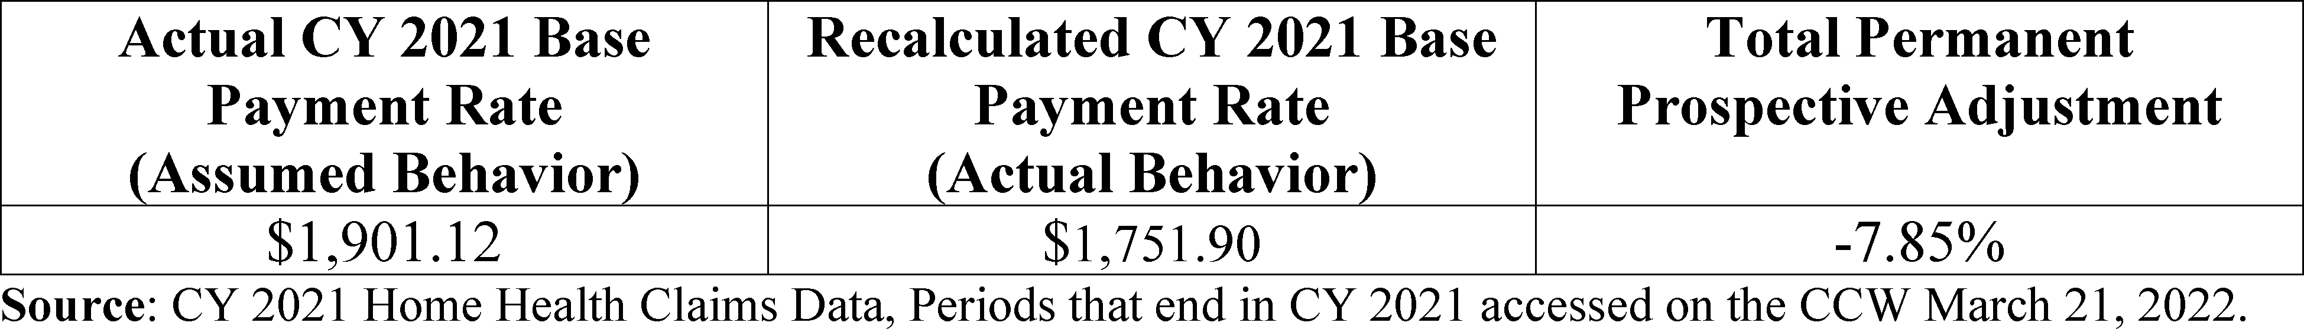
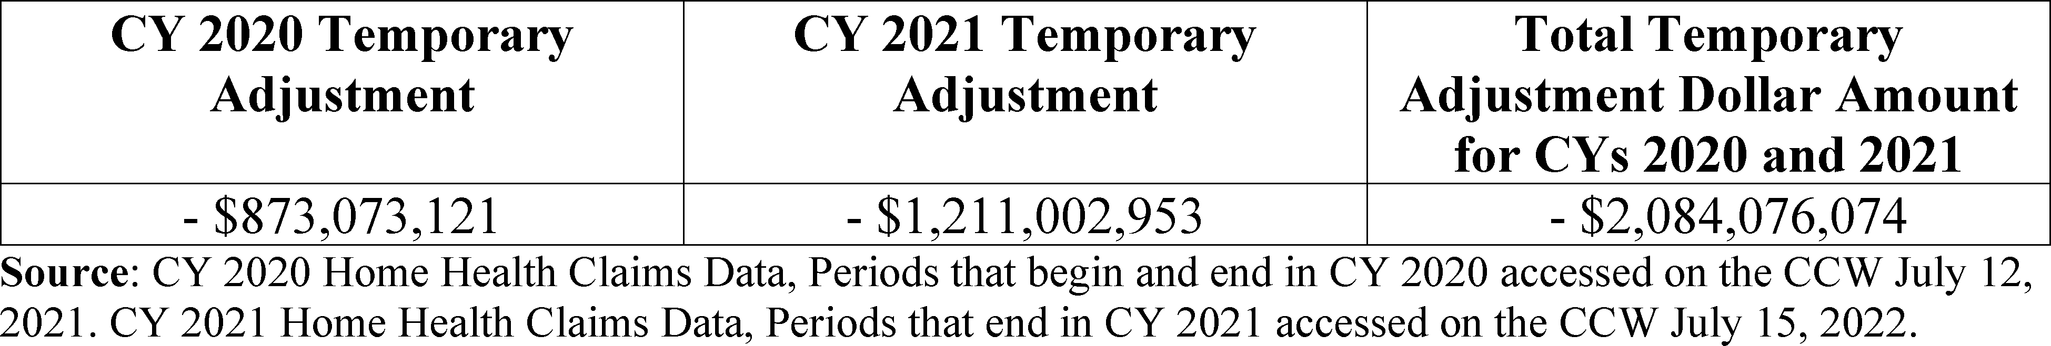
CY 2023 Permanent and Temporary Adjustment
Total Permanent Adjustment for CYs 2020 and 2021
Total Temporary Adjustment for CYs 2020 and 2021
To offset the increase in estimated aggregate expenditures for CYs 2020 and 2021 based on the impact of the differences between assumed and actual behavior changes, CMS would need to apply a −7.85 percent permanent adjustment to the CY 2023 base payment rate as well as implement a temporary adjustment of approximately $2.1 billion to reconcile retrospective overpayments in CYs 2020 and 2021.

Slide 18
CY 2023 Permanent Adjustment
Applying the full permanent adjustment would likely result in a significant negative adjustment in a single year.
Recognizing the potential hardship of implementing the full −7.85 percent permanent adjustment in a single year, in the CY 2023 HH PPS final rule, CMS finalized a −3.925 percent (half of the −7.85 percent) permanent adjustment for CY 2023.
However, the -3.925% would not adjust the rate fully to account for differences in behavior changes on estimated aggregate expenditures during CYs 2020 and 2021, as well as in CYs 2022 and 2023.
CMS would have to account for that difference, and any other potential adjustments needed to the base payment rate, to account for behavior change based on data analysis in future rulemaking.

Slide 19
Temporary Payment Adjustment
While we did not propose to adjust the CY 2023 payment rate using our temporary adjustment authority for CYs 2020 and 2021, we did solicit comments on how best to implement the temporary adjustment.
Many commenters recommended a phase-in of the temporary adjustment over several years and suggested another year delay before proposing to make the temporary adjustment to the payment rate.
The law allows the Secretary the discretion to implement the temporary payment adjustment in a time and manner determined appropriate.

Slide 20
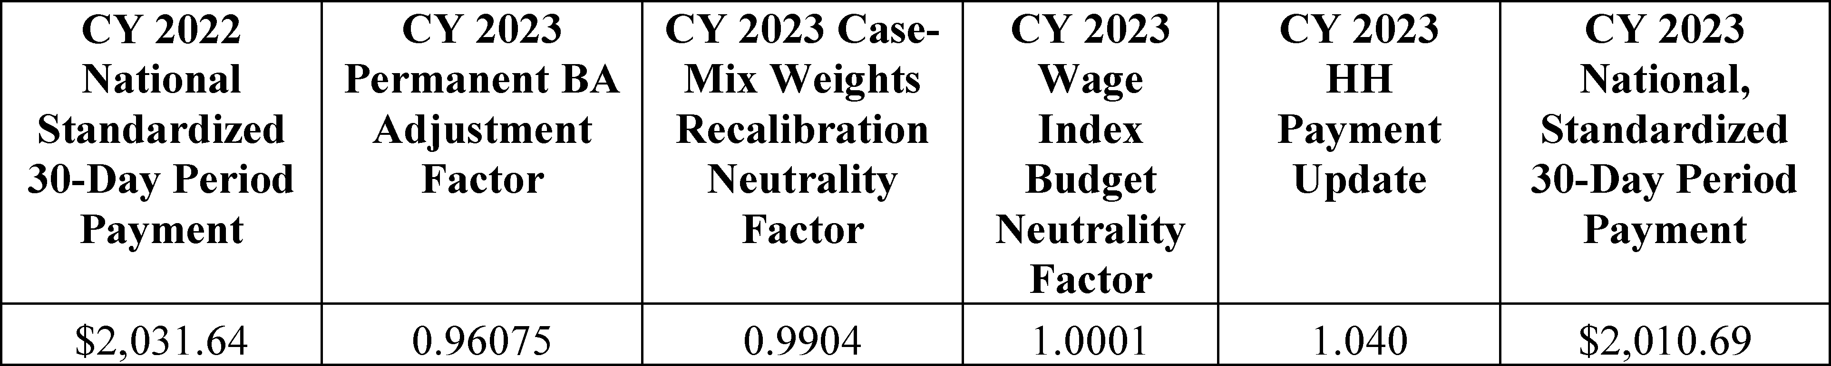
Home Health Payment Update
The CY 2023 home health payment update percentage was 4.0 percent.
CY 2023 National, Standardized 30-Day Period Payment Amount

Slide 21
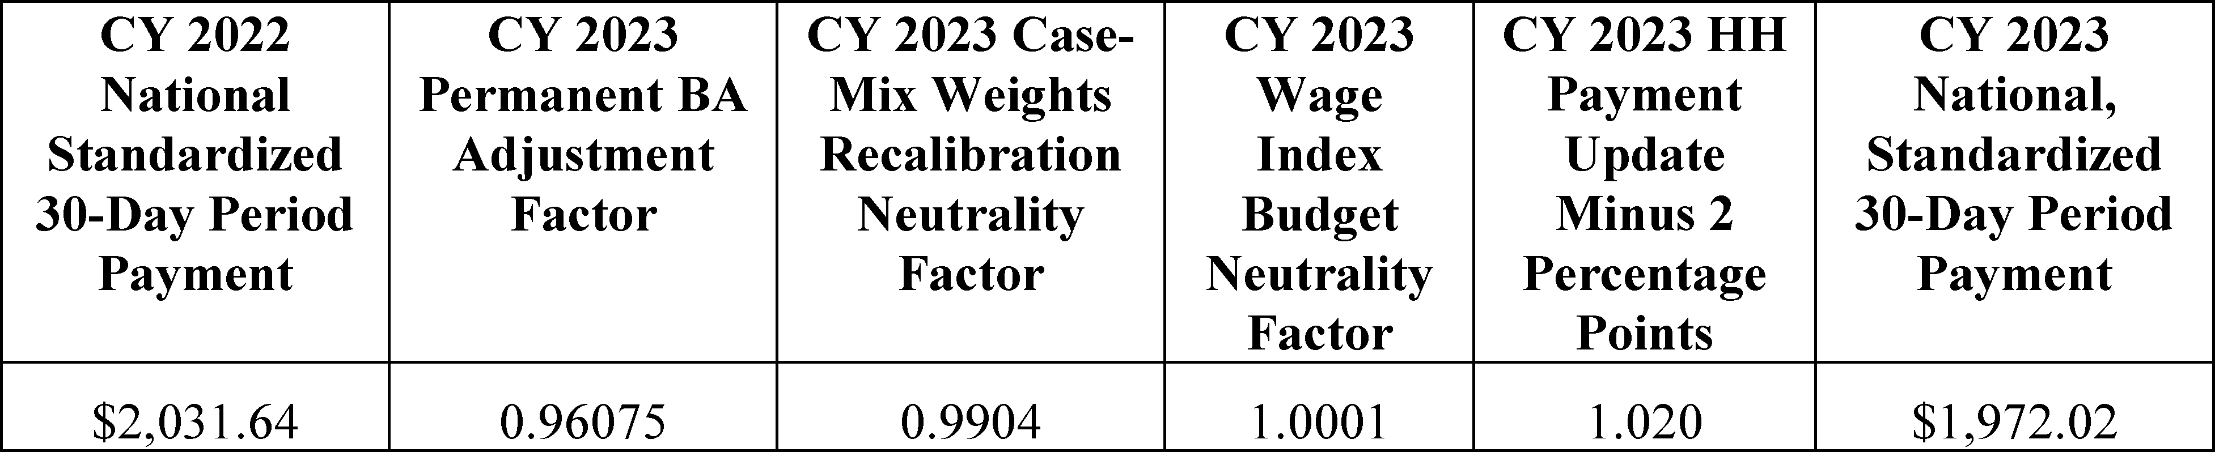
Home Health Payment Update
The CY 2023 national, standardized 30-day period payment rate for a HHA that does not submit the required quality data is updated by the CY 2023 home health payment update of 4.0 percent minus 2 percentage points.
CY 2023 National, Standardized 30-Day Period Payment Amount for HHAS That Do Not Submit the Quality Data

Slide 22
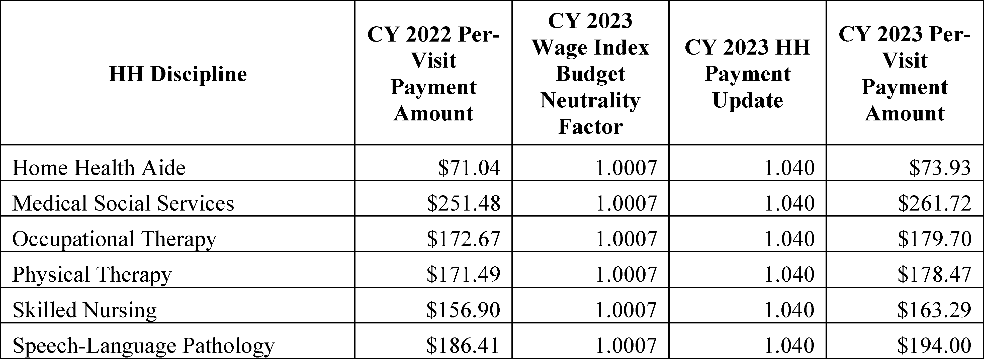
CY 2023 National Per-Visit Payment Amounts
The CY 2023 national per-visit rates for HHAs that submit the required quality data are updated by the CY 2023 home health payment update percentage of 4.0 percent.
CY 2023 National Per-Visit Payment Amounts

Slide 23
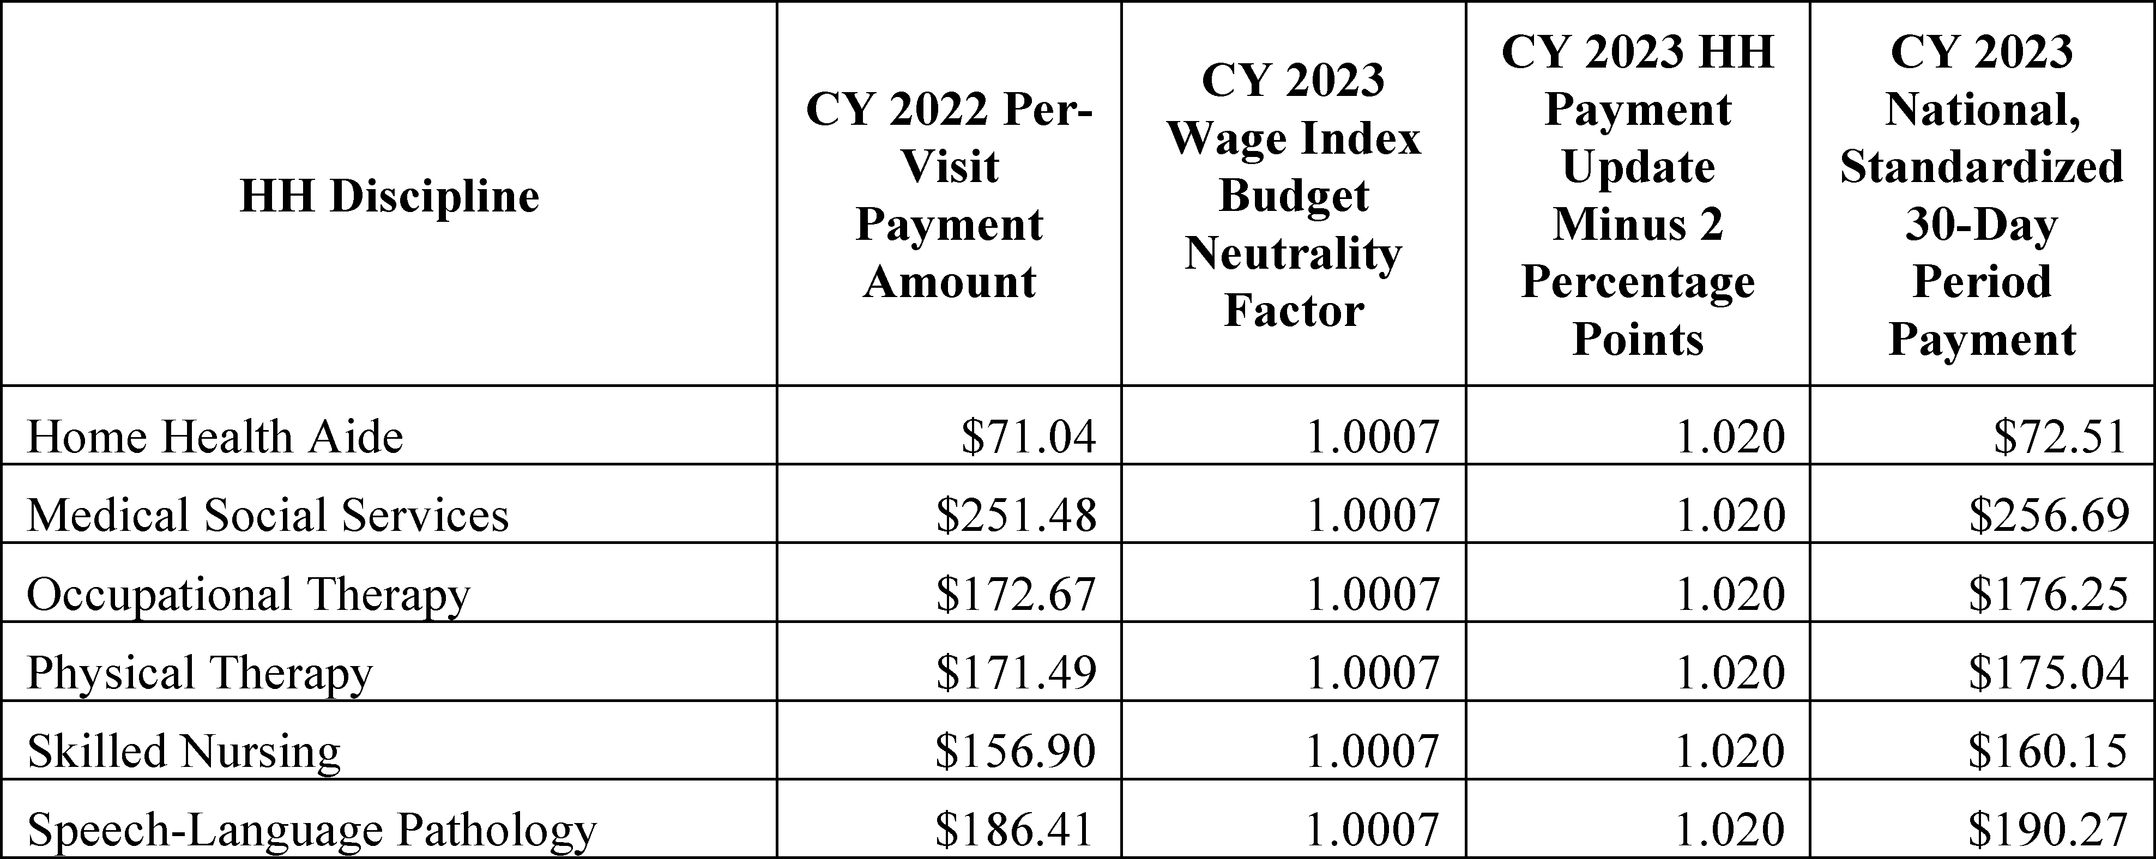
CY 2023 National Per-Visit Payment Amounts
The CY 2023 per-visit payment rates for HHAs that do not submit the required quality data are updated by the CY 2023 home health payment update percentage of 4.0 percent minus 2 percentage points.
CY 2023 National Per-Visit Payment Amounts for HHAS That Do Not Submit the Required Quality Data

Slide 24
Reassignment of ICD-10 Diagnosis Codes
The purpose of any reassignment is to ensure that diagnoses are assigned to the appropriate clinical group or comorbidity subgroup and to align as closely as possible to ICD–10– CM coding conventions and MCE edits.
For CY 2023, we finalized the reassignment of the 155 unspecified ICD–10 CM diagnosis codes from their current assigned clinical group to N/A when the codes are listed as a principal diagnosis.
Other changes include clinical group reassignment for diagnosis codes related to gout, crushing injury to the face, and lymphedema.
All the changes are available in the CY 2023 Final Home Health Clinical Group and Comorbidity Adjustment Diagnosis List posted on the Home Health Prospective Payment System Regulations and Notices webpage.

Slide 25
Recalibration
In the CY 2019 HH PPS final rule, we finalized our proposal to annually recalibrate the PDGM case-mix weights (83 FR 56515) to reflect the most recent utilization data available at the time of rulemaking.
Annual recalibration ensures that the case-mix weights reflect, as accurately as possible, current home health resource use, changes in utilization patterns, and reflects the types of patients currently receiving home health services.
Recalibration is done in a budget-neutral manner through the application of a case-mix weight budget neutrality factor to the 30-day payment rate. For CY 2023, this factor is 0.9904.
Recalibration ensures there is variation in payment between the 432 case-mix groups so that those groups with lower resource use get paid less than those with higher resource use.
In the CY 2023 HH PPS final rule, CMS finalized to update the functional points and functional impairment levels using CY 2021 claims data.

Slide 26
CY 2023 PDGM LUPA Thresholds
In the CY 2019 HH PPS final rule, we finalized setting the LUPA thresholds at the 10th percentile of visits or 2 visits, whichever is higher, for each payment group. This means the LUPA threshold for each 30-day period of care varies depending on the PDGM payment group to which it is assigned.
If the LUPA threshold for the payment group is met under the PDGM, the 30-day period of care will be paid the full 30-day period case-mix adjusted payment amount (subject to any PEP or outlier adjustments).
If a 30-day period of care does not meet the PDGM LUPA visit threshold, then payment will be made using the CY 2023 per-visit payment amounts.
CMS did not update the LUPA thresholds in CYs 2021 or 2022. However, for CY 2023, we did finalize to update the LUPA thresholds.
The case-mix weights for CY 2023 and LUPA thresholds are available on the HHA Center web page.

Slide 27
FDL Ratio
For a given level of outlier payments, there is a trade-off between the values selected for the FDL ratio and the loss sharing ratio.
A high FDL ratio reduces the number of periods that can receive outlier payments, but makes it possible to select a higher loss-sharing ratio, and therefore, increase outlier payments for qualifying outlier periods.
A lower FDL ratio means that more periods can qualify for outlier payments, but outlier payments per period must be lower.
We finalized the fixed-dollar loss ratio of 0.35 for CY 2023, in order to ensure that total outlier payments do not exceed 2.5 percent of the total aggregate payments, as required by section 1895(b)(5)(A) of the Act.

Slide 28
Wage Index Cap
CMS finalized, for CY 2023 and subsequent years, the application of a permanent 5-percent cap on any decrease to a geographic area's wage index from its wage index in the prior year, regardless of the circumstances causing the decline.
A geographic area's wage index for CY 2023 would not be less than 95 percent of its final wage index for CY 2022, regardless of whether the geographic area is part of an updated CBSA, and that for subsequent years, a geographic area's wage index would not be less than 95 percent of its wage index calculated in the prior CY.

Slide 29
Telehealth
Recognizing the importance of the use of telecommunications technology in the provision of home health services during the COVID-19 PHE, CMS finalized changes to allow for the use of telecommunications technology.
Telecommunications technology can be ordered as part of a home health plan of care but such services cannot be reported as a visit without the provision of another skilled service.
The CY 2021 HH PPS final rule (85 FR 70298) finalized these changes on a permanent basis, as well as amended the regulations to include not only remote patient monitoring, but other communication or monitoring services consistent with the plan of care for the individual, on the home health cost report as allowable administrative costs.

Slide 30
Telehealth G-Codes
Starting on or after January 1, 2023, there is voluntary reporting for the use of telecommunications technology in providing HH services on HH payment claims.
Beginning on July 1, 2023, this information will be mandatory to be reported on HH claims using the following three G-codes:
  G0320: Home health services furnished using synchronous telemedicine rendered via a real-time two-way audio and video telecommunications system
  G0321: Home health services furnished using synchronous telemedicine rendered via telephone or other real-time interactive audio-only telecommunications system
  G0322: The collection of physiologic data digitally stored and/or transmitted by the patient to the home health agency (for example, remote patient monitoring)

Slide 31
Impacts for CY 2023
Overall, it is projected that aggregate payments in CY 2023 would increase by 0.7 percent (or an increase of $125 million) which reflects the 3.5 percent decrease from the permanent behavioral adjustment, the 4.0 payment update percentage increase, and the 0.2 percent increase from lowering the FDL.

Slide 32
CAA, 2023 Requirements
SEC. 4142. INCREASING TRANSPARENCY FOR HOME HEALTH PAYMENTS UNDER THE MEDICARE PROGRAM.
Requires the Secretary, within 90 days after enactment, to use an open-door forum, a town hall meeting, a web-based forum, or other appropriate mechanism to receive input from home health stakeholders and interested parties on Medicare home health payment rate development. Additionally, 30 days before this meeting, the Secretary is required to release electronic data files showing specific data simulations and, to the extent practical, a description of the actual behavior changes that occurred with respect to the home health prospective payment system rate for 2023.
In future rulemaking, the Secretary is required to release electronic data files showing specific data simulations if such data is used in determining a payment adjustment, as well as, to the extent practicable, a description of the actual behavior changes that occurred in 2020 through 2026.

Slide 33
Webinar Information
CMS posted the required materials on the PDGM webpage on February 28, 2023.
An overview of several provisions from the CY 2023 HH PPS final rule related to behavior changes, the construction of 60-day episodes, and payment rate development for CY 2023 will be provided during the “Medicare Home Health Prospective Payment System (HH PPS) Calendar Year (CY) 2023 Behavior Change Recap, 60-Day Episode Construction Overview, and Payment Rate Development Webinar”
This webinar will be held on:
Mar 29, 2023 01:30 PM in Eastern Time (US and Canada)
All interested parties must register to attend using the registration link found on the PDGM webpage:
https://www.cms.gov/medicare/medicare-fee-for-service-payment/homehealthpps/hh-pdgm

Slide 34
Resources
Home Health Patient-Driven Groupings Model
CY 2023 Home Health Final Rule
Consolidated Appropriations Act, 2023
Home Health Prospective Payment System Limited Data Set
HomeHealthPolicy@cms.hhs.gov

Slide 35

Questions

